Slide 1
Image Enhancement in the Frequency Domain
Deepak Kumar Rout

Slide 2
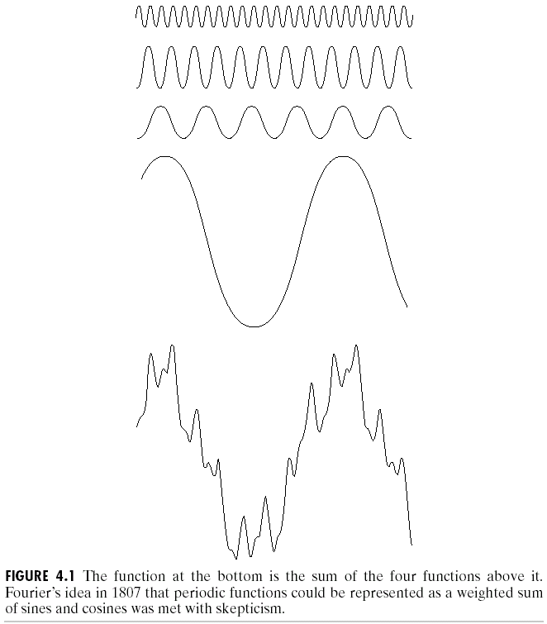
Fourier Series
Any function that periodically
repeats itself can be expressed
as the sum of sines and/or cosines of different frequencies, each multiplied by a different coefficients. This sum is called a Fourier series.

Slide 3
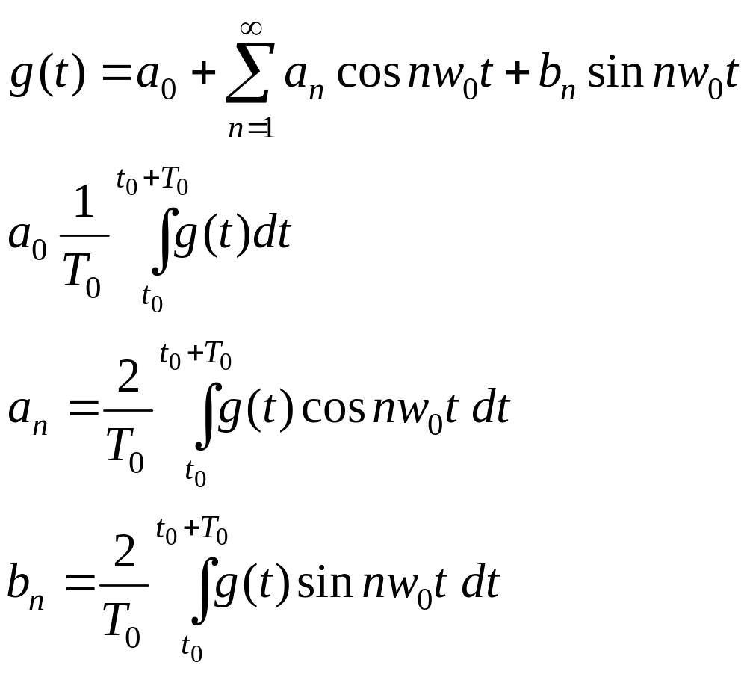
Fourier Series

Slide 4
Fourier Transform
A function that is not periodic but the area under its curve is finite can be expressed as the integral of sines and/or cosines multiplied by a weighing function. The formulation
in this case is Fourier transform.

Slide 5
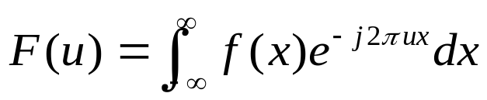
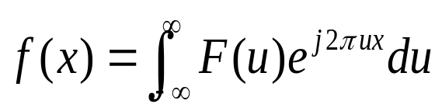
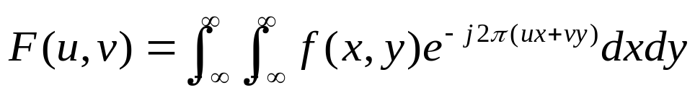
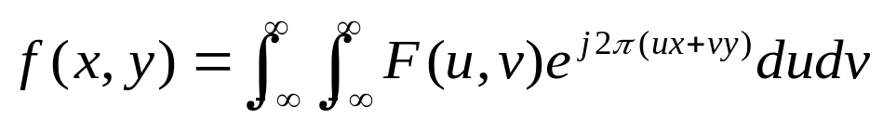
The One-Dimensional Fourier Transform and its Inverse
The fourier transform F(u) :
The inverse Fourier transform f(x) :
Two variables Fourier transform F(u, v) :
The inverse transform f(x, y) :

Slide 6
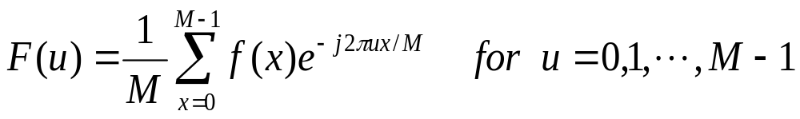
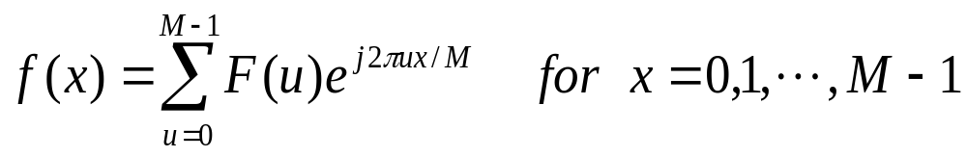
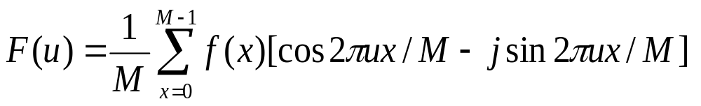
The One-Dimensional Fourier Transform and its Inverse
The discrete Fourier Transform F(u) :
The inverse DFT :
Apply euler’s formula :

Slide 7
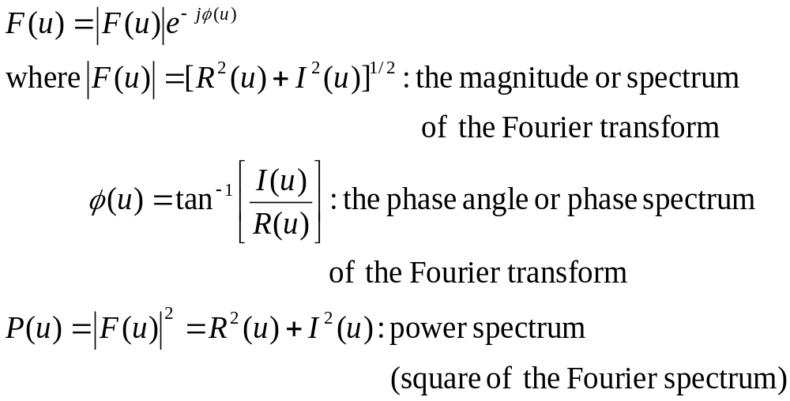
The One-Dimensional Fourier Transform and its Inverse
F(u) in polar coordinates :

Slide 8
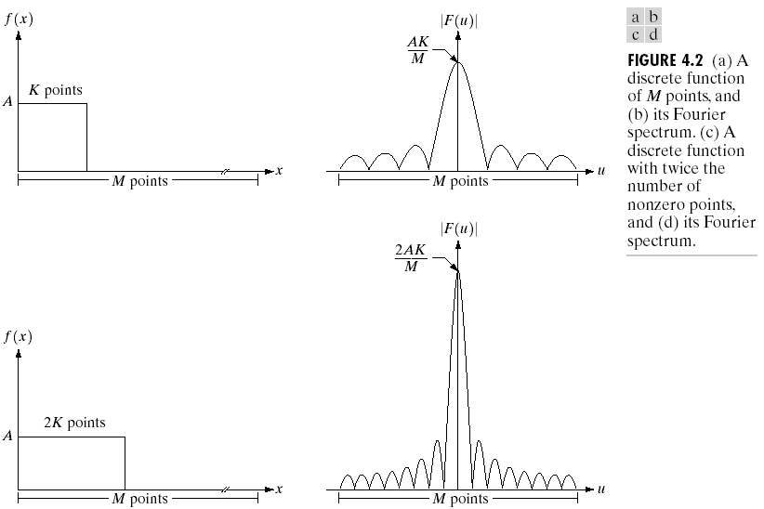
The One-Dimensional Fourier Transform and its Inverse

Slide 9
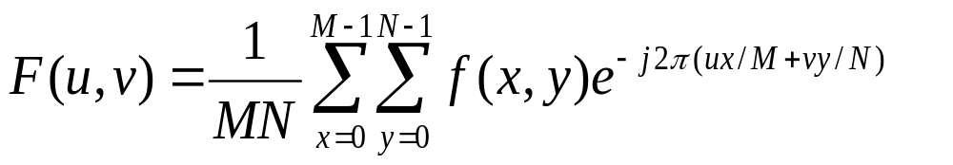
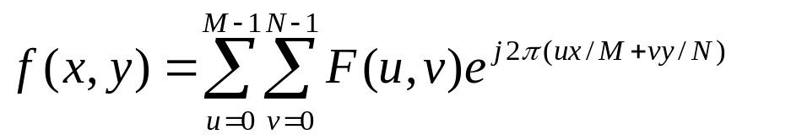
The two dimensional DFT and its Inverse
The discrete fourier transform of a function f(x,y) of size M x N :
The inverse Fourier transform :

Slide 10
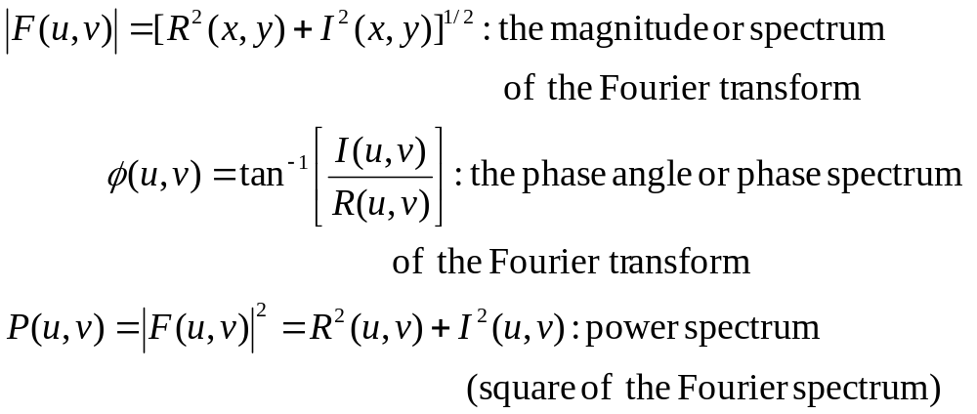
The two dimensional DFT and its Inverse
In the polar coordinate

Slide 11
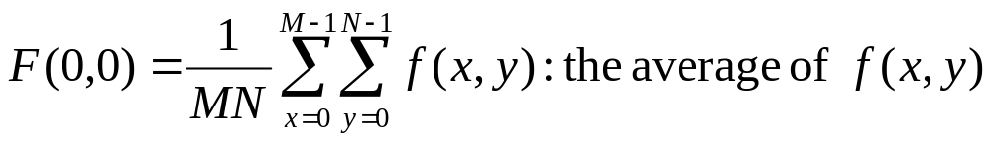
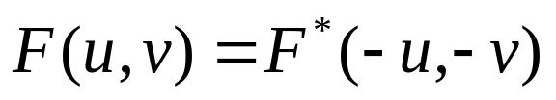
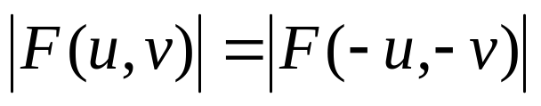
The two dimensional DFT and its Inverse
DFT corresponding (u,v)=(0,0)
If f(x,y) is real, its Fourier transform is conjugate symmetric
The spectrum of the Fourier transform is symmetric

Slide 12
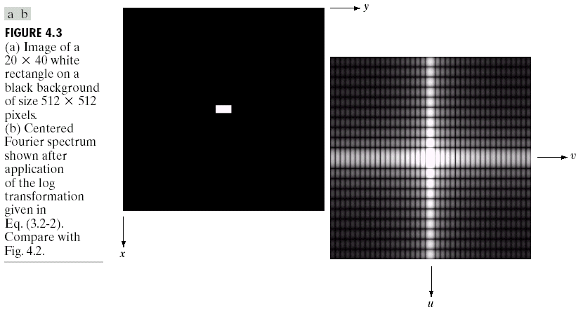
The two dimensional DFT and its Inverse

Slide 13

Basics of filtering in the frequency domain
Multiply the input image by to center the transform
Compute F(u,v), by the DFT of the image from (1)
Multiply F(u,v) by a filter function H(u,v)
Compute the inverse DFT of the result in (3)
Obtain the real part of the result in (4)
Multiply the result in (5) by

Slide 14
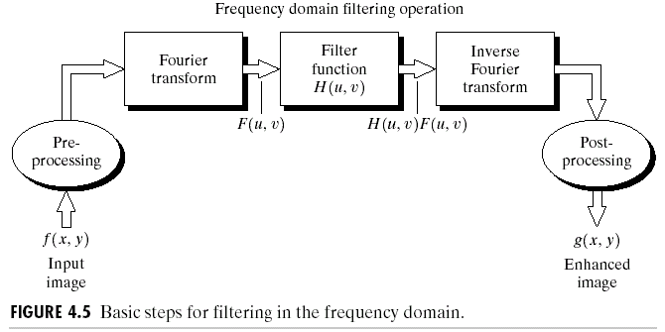
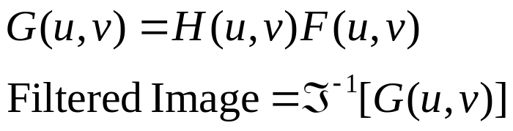
Basics of filtering in the frequency domain

Slide 15
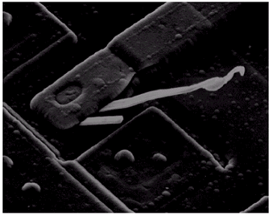
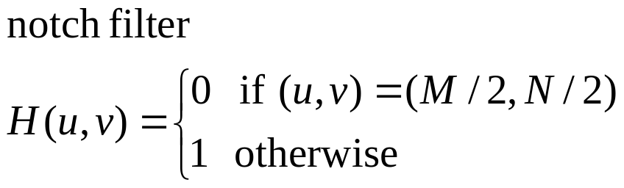
Some basic filters and their properties

Slide 16
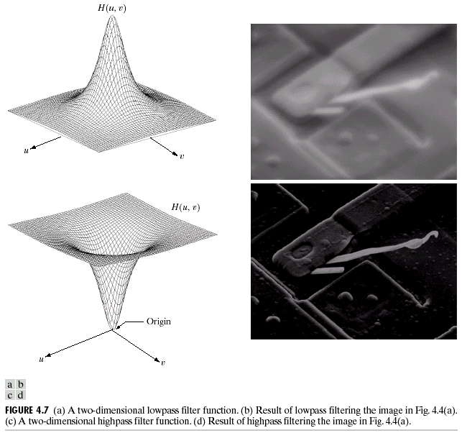
Some basic filters and their properties
Lowpass filter : less sharp
(Smoothing)
Highpass filter : less gray-level variation and emphasized edges
(Sharpening)

Slide 17
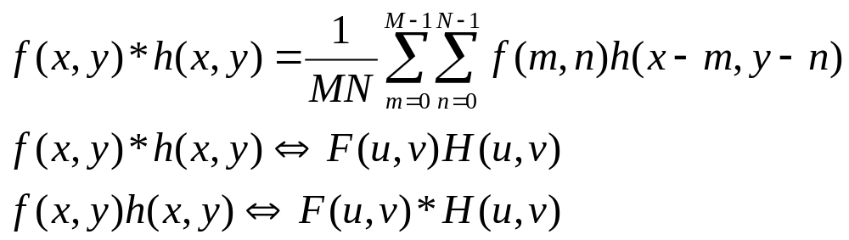
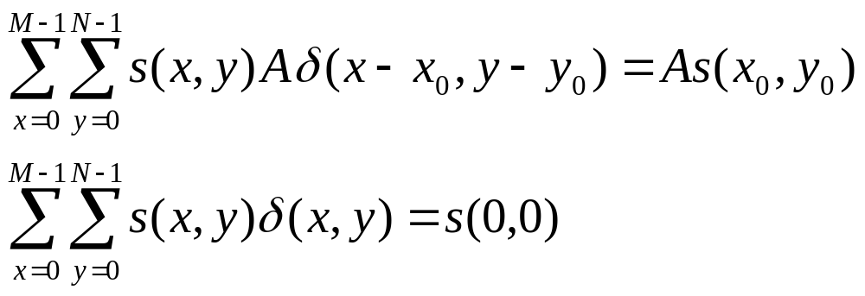
Correspondence between Filtering in the Spatial and Frequency Domains
The convolution theorem :
The impulse response :

Slide 18
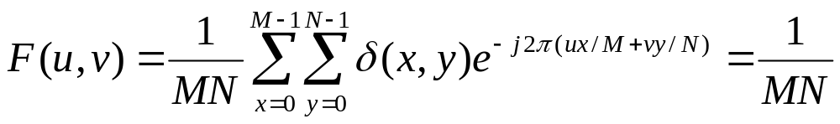

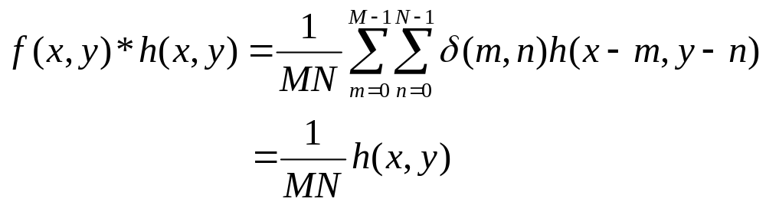
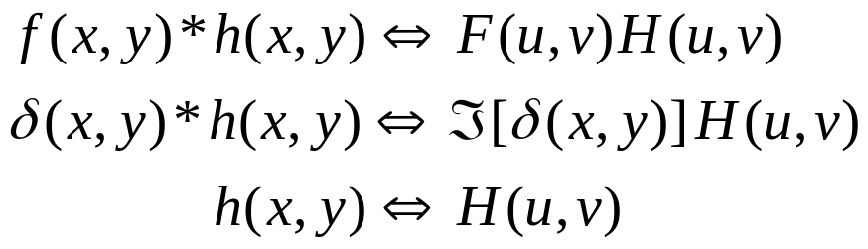
Correspondence between Filtering in the Spatial and Frequency Domains
The Fourier transform of a unit impulse function
Let

Slide 19
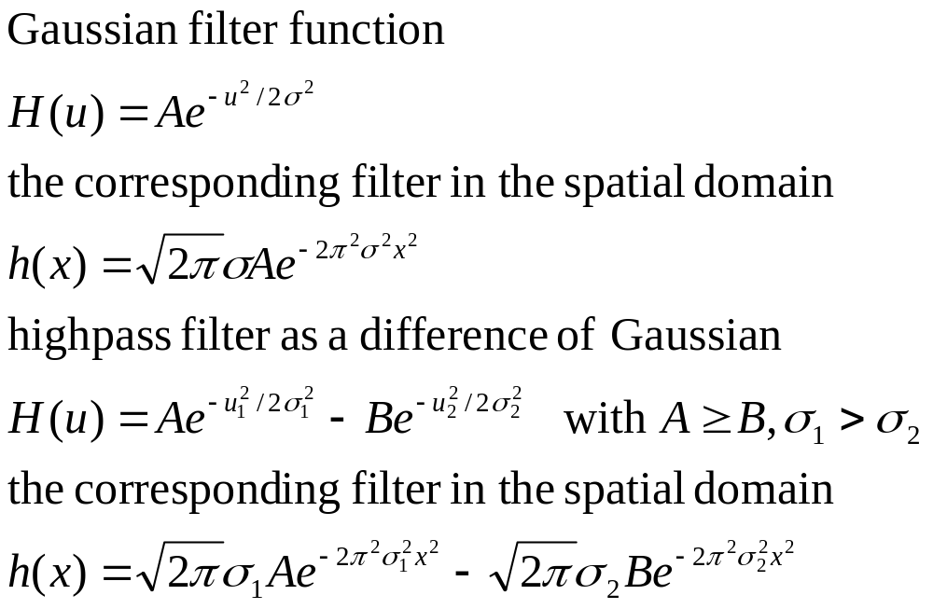
Correspondence between Filtering in the Spatial and Frequency Domains
Gaussian functions :

Slide 20
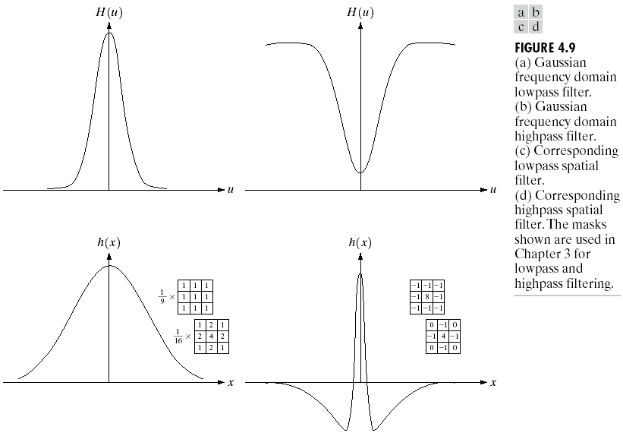
Correspondence between Filtering in the Spatial and Frequency Domains

Slide 21
Smoothing Frequency-Domain Filters
Ideal
Butterworth
Gaussian

Slide 22
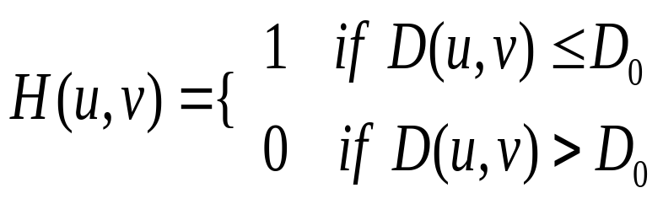
Ideal lowpass filter

Slide 23
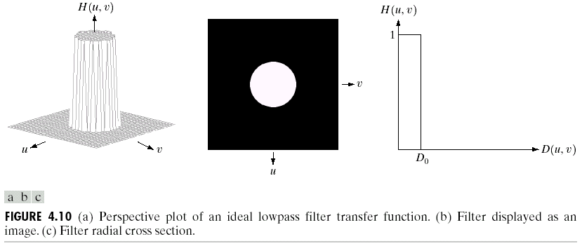
Ideal lowpass filter

Slide 24
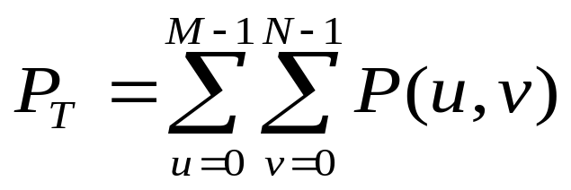
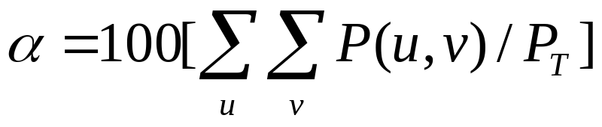
Ideal lowpass filter

Slide 25
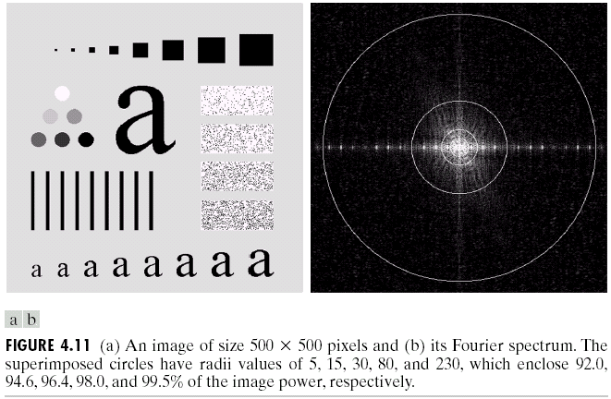
Ideal lowpass filter

Slide 26
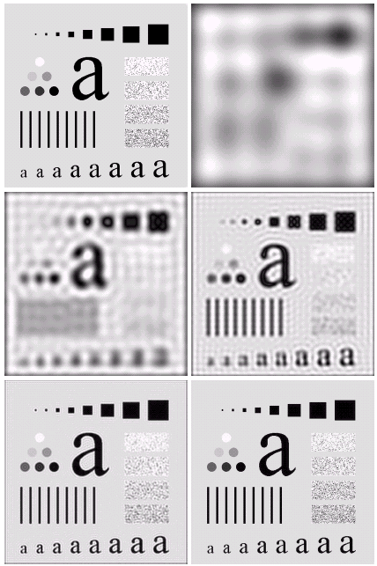
Ideal lowpass filter

Slide 27
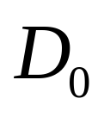
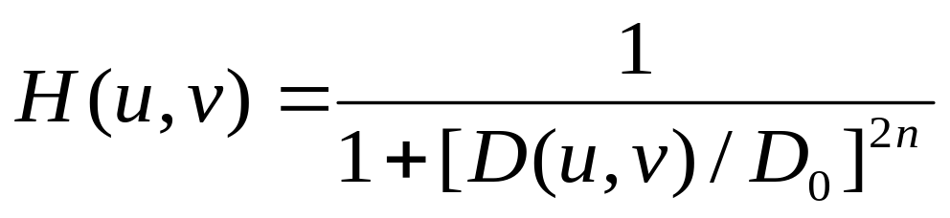
Butterworth Lowpass Filters
When D(u,v)= , H(u,v)=0.5

Slide 28
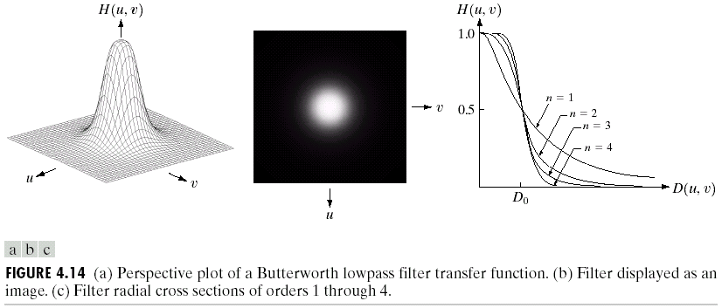
Butterworth Lowpass Filters

Slide 29
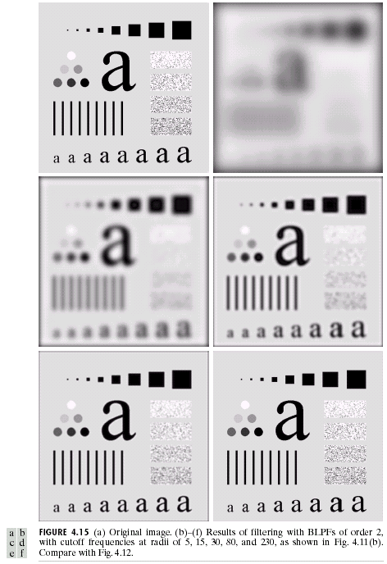
Butterworth Lowpass Filters

Slide 30
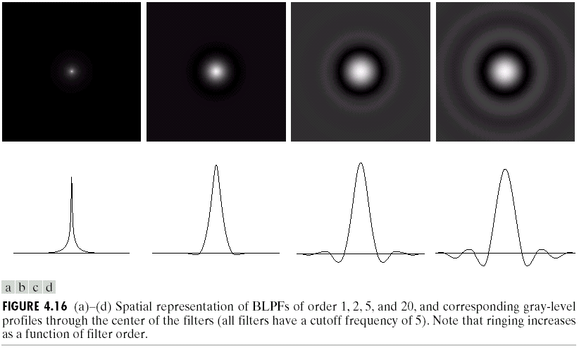
Butterworth Lowpass Filters

Slide 31
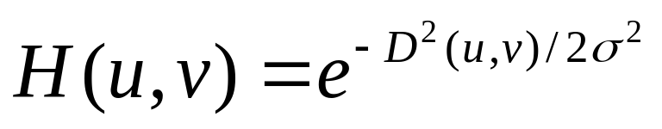
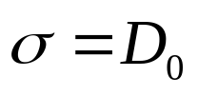
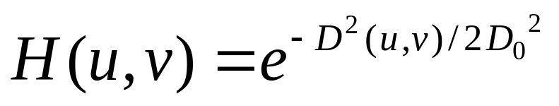
Gaussian Lowpass filter
let

Slide 32
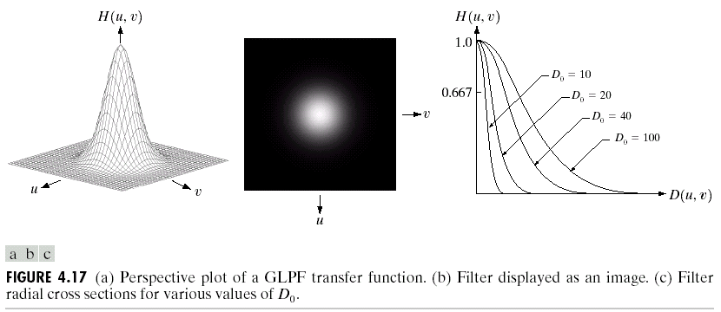
Gaussian Lowpass filter

Slide 33
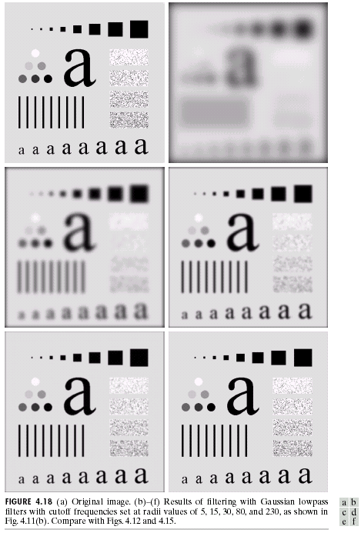
Gaussian Lowpass filter

Slide 34
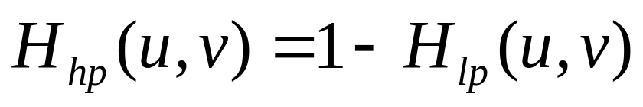
Sharpening Frequency Domain Filters
Ideal
Butterworth
Gaussian

Slide 35
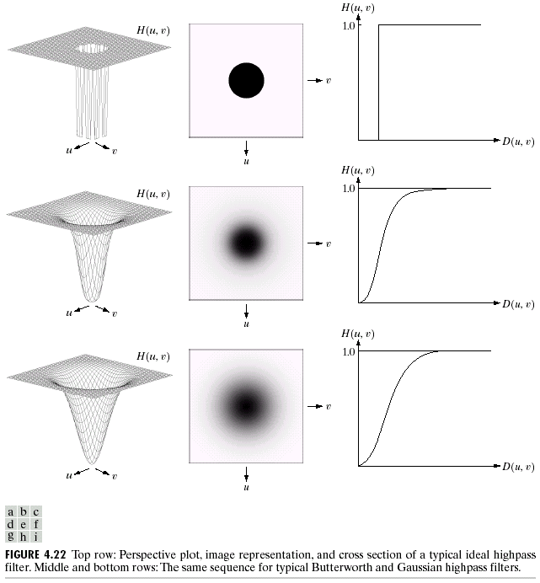
Sharpening Frequency Domain Filters

Slide 36
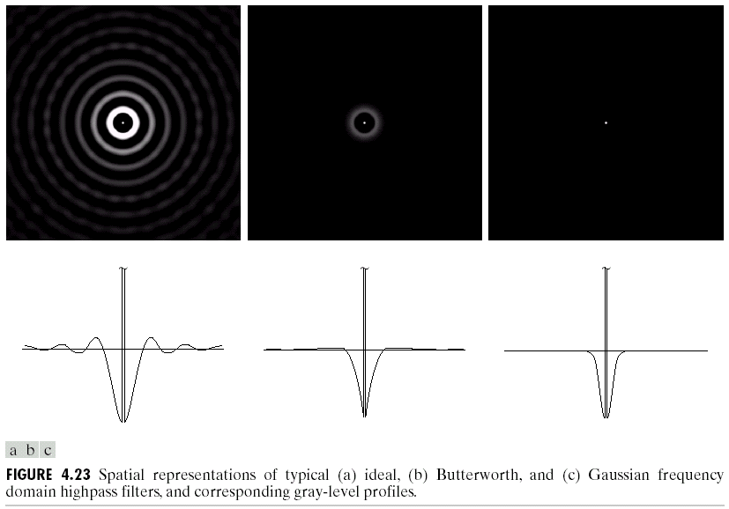
Ideal Highpass Filters

Slide 37
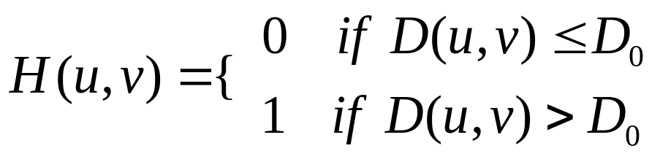

Ideal highpass filter

Slide 38


Butterworth Highpass Filters

Slide 39


Gaussian Highpass Filters

Slide 40




The Laplacian in the Frequency Domain

Slide 41

The Laplacian in the Frequency Domain

Slide 42


The Laplacian in the Frequency Domain

Slide 43




Unsharp Masking, High-Boost Filtering, and High-Frequency Emphasis Filtering
Unsharp masking :
High-Boost filtering :
High-Frequency Emphasis Filtering

Slide 44

Unsharp Masking, High-Boost Filtering, and High-Frequency Emphasis Filtering

Slide 45

Unsharp Masking, High-Boost Filtering, and High-Frequency Emphasis Filtering

